Slide 1



Emotions and Politics: A Computational Social Science Perspective? or Using surveys, experiments, simulations, text analysis, physiology and the brain to study emotions in politics.
Gijs Schumacher
University of Amsterdam
Notes:
Did not have a presentation geared towards CSS audience
In fact, I am not even sure what CSS is
First contact -> Duke -> fantastic models
Fascinated, but also puzzled; engineer mentality to science IC2SC
Yesterday when I prepared this – i wanted to express these feelings i had, and so I asked CHATgpt

Slide 2
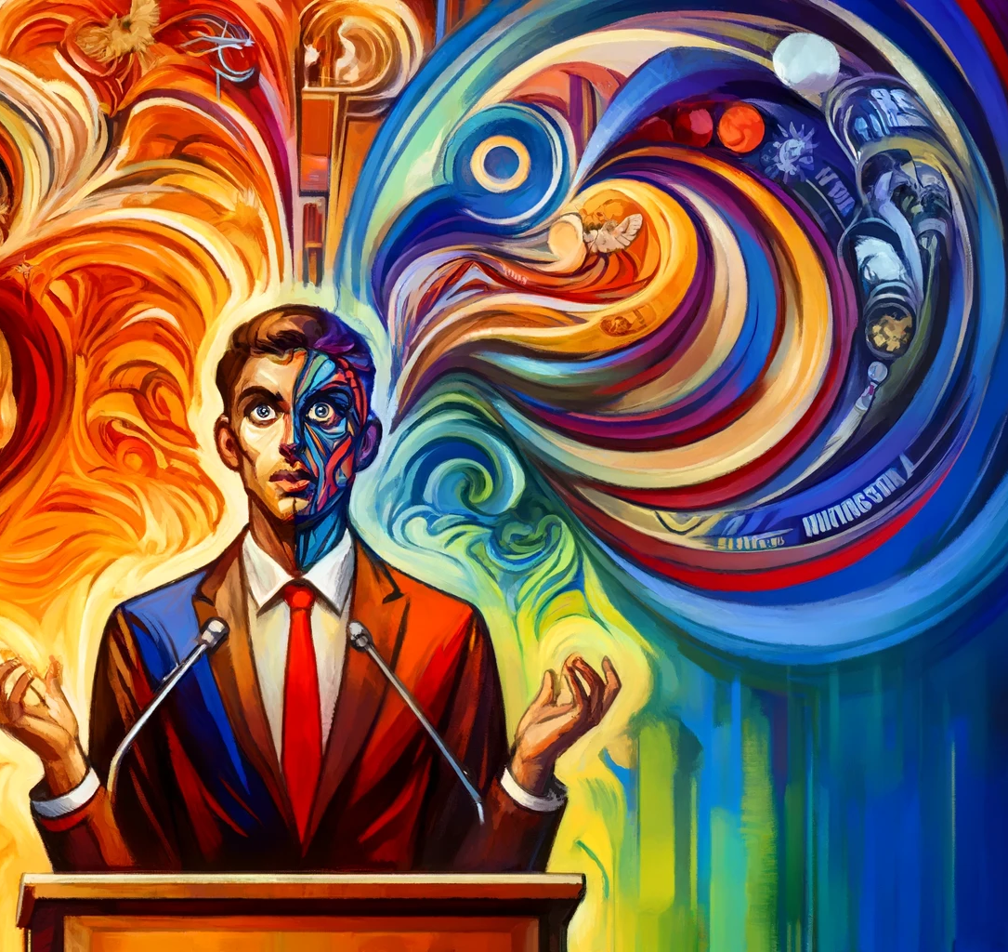
“I have to give a keynote speech about Computational Social Science tomorrow. I am not really an expert on this topic. But I have always been puzzled and fascinated by this field. I have done some work in this field, but i also feel out of touch with the broader field. My broader topic of research is Emotions in Politics. Can you make an artistic illustration using an expressionist painting style based on these instructions? “
Notes:
In preparing I felt I had quite different goals
Say something about emotions and politics
Say something about CSS
Say something about my CSS projects
So many different starting points. What is the organizing principle?
Remember: Duke CSS -> map-making

Slide 3
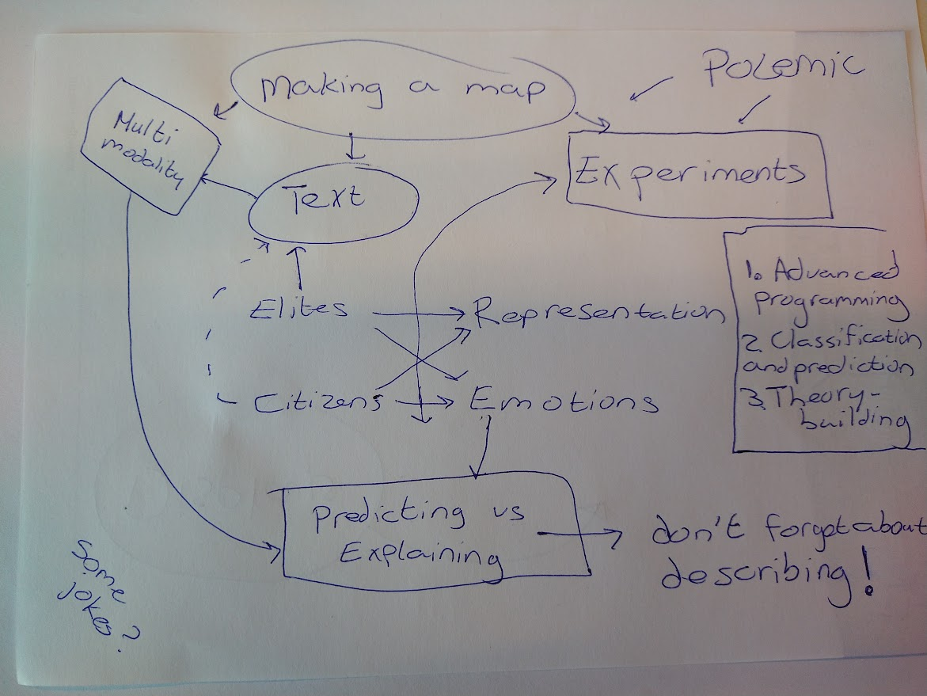

Slide 4
What is computational social science?
Advanced programming to improve designs of experiments
Methods to improve collection, classification and prediction
A theory-building tool

Slide 5
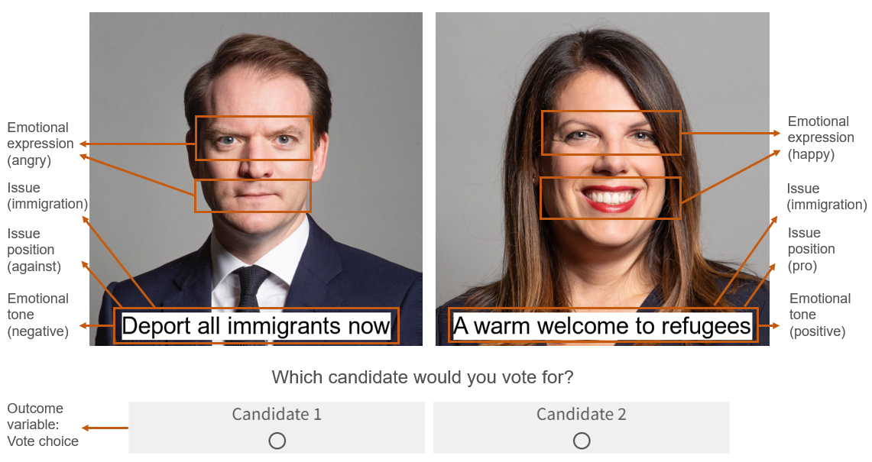
1. Programming experiments
Note: Homan, M. D., & Schumacher, G. (2023). Examining the Influence of Politicians’ Emotional Appeals on Vote Choice using a Visualized Leader Choice Task. PsyArXiv. https://doi.org/10.31234/osf.io/cgqzw

Slide 6
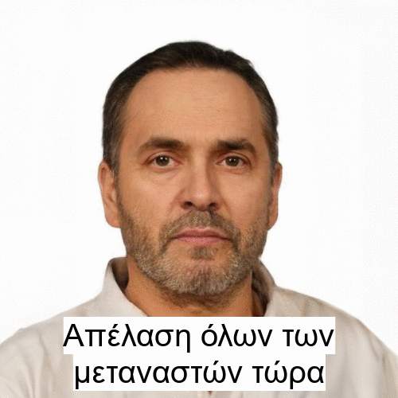

Slide 7
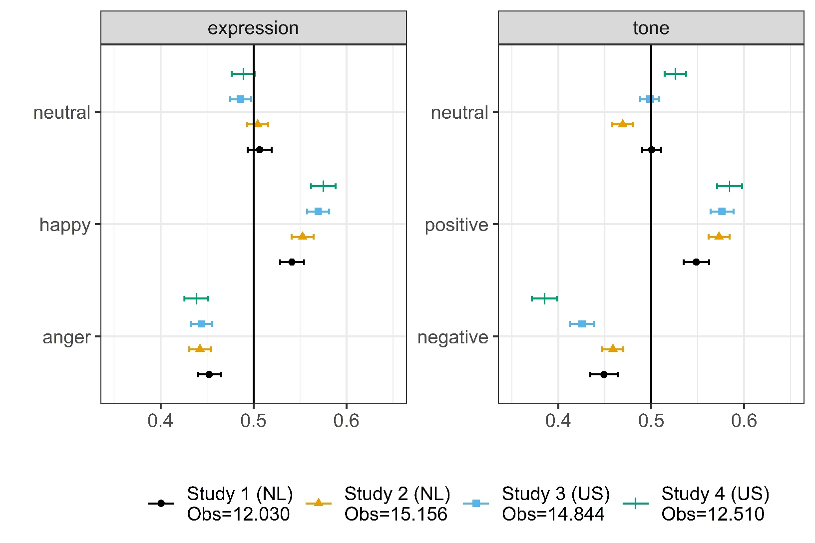
Positive emotions are more popular
Note: Figure shows the results of four experimental studies that use the same so-called election poster task. In this task participants are shown two election posters. These posters show two candidates. In these posters we manipulate the (angry, happy or neutral) expression of the candidate, the position the candidate expresses in a slogan and the tone of that slogan (positive, negative or neutral). Figure shows the marginal means: the proportion of participants voting for candidates that have a particular expression or tone. These results show that participants consistently favor positive tone and happy expressions and dislike angry expressions and negative tone. See Homan & Schumacher (2023).

Slide 8
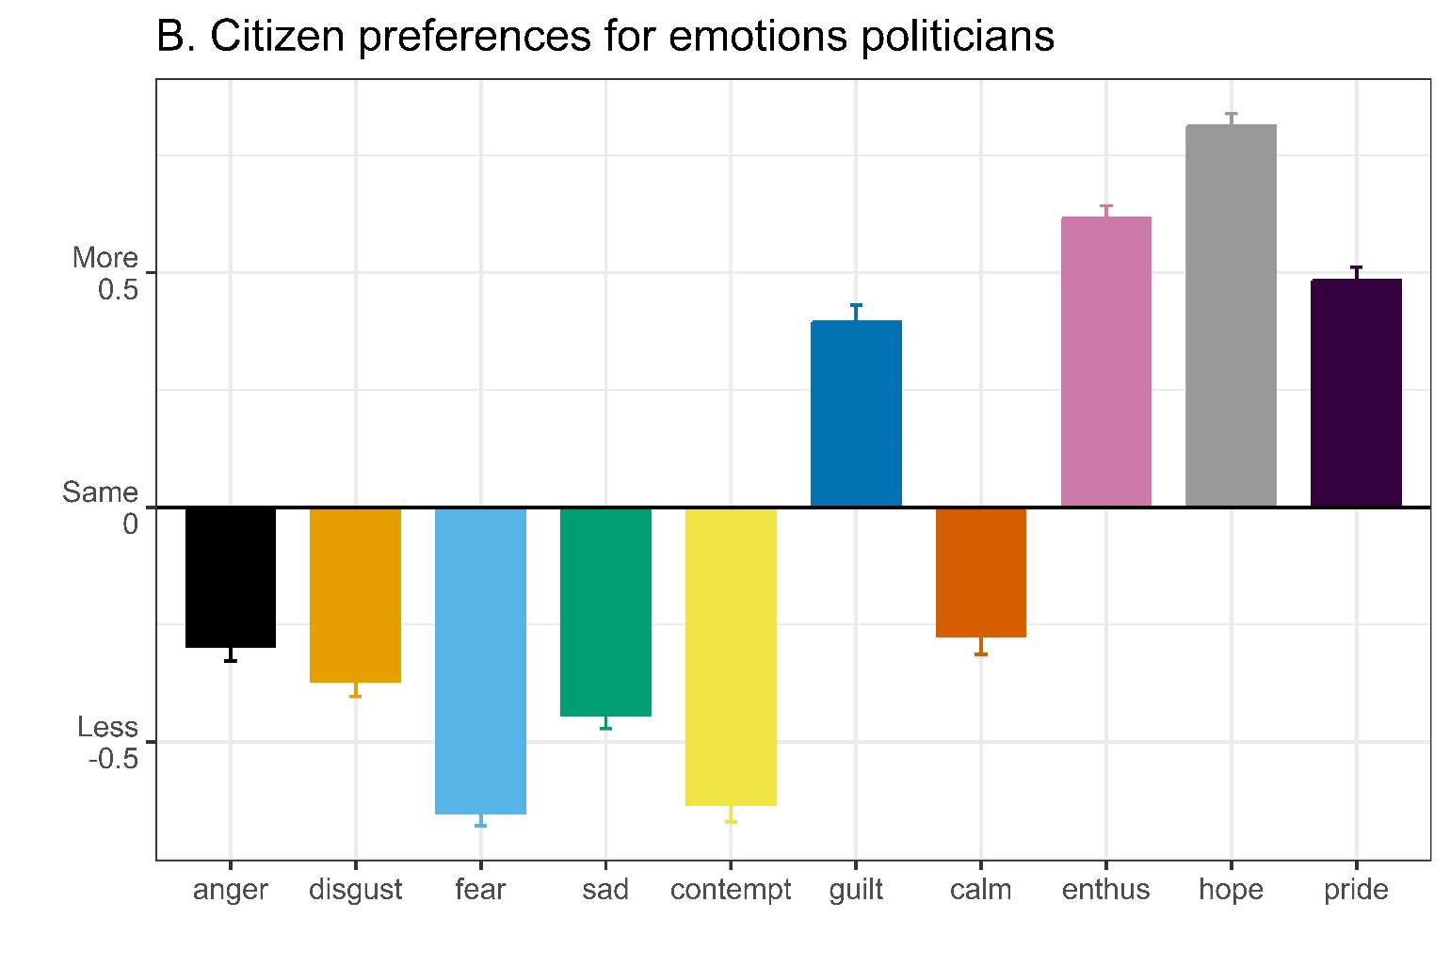
Citizens want more positive emotions
Note: Figure shows survey responses to the question whether people wanted the leader of the party they vote for to use more or less anger, disgust, fear, sadness, contempt, guilt, calmness, enthusiasm, hope and pride. It summarizes results from four independent samples (2 American, 2 Dutch). The pattern of wanting fewer negative emotions and more positive emotions replicates across the studies, the two countries and the different voter groups.

Slide 9
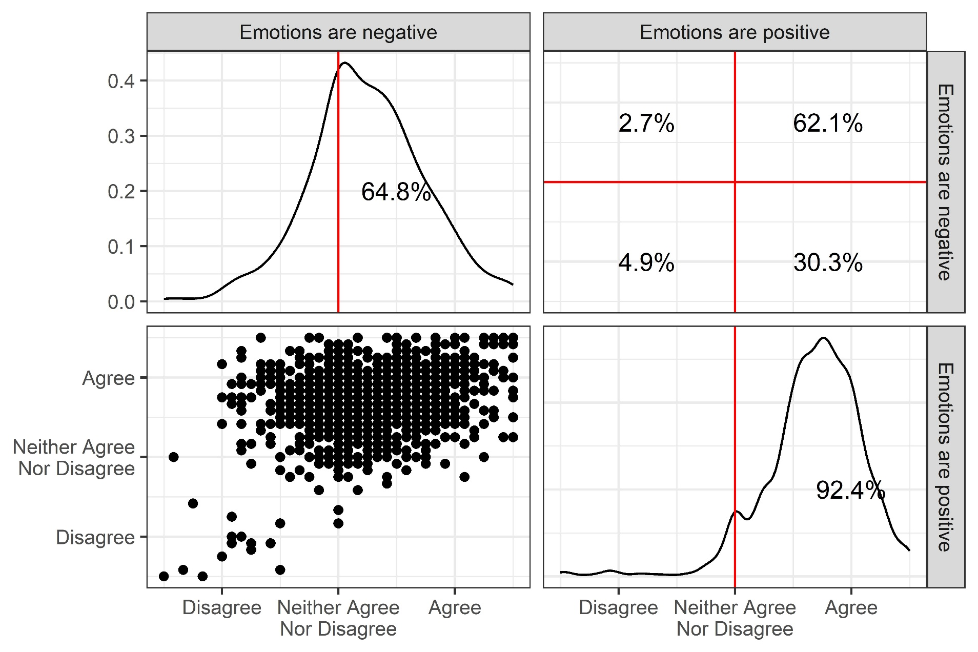
Citizens want more positive emotions

Slide 10
1. Programming experiments
Using chatGPT to talk to people
Capable of providing persuasive arguments (Hackenburg and Margetts 2024)
Allows for designs with more power (within-subjects) and stronger internal validity (obs -> exp)
More gamified experiments
More specific modelling of response behaviors
Notes:
Overall conclusion: CSS offers tool to supercharge social science

Slide 11
2. Methods to improve collection, classification and prediction
Text analysis
- Ideology - Morality
- Topic salience - Emotion
- Speaker relations - Personality
- Complexity of speech

Slide 12
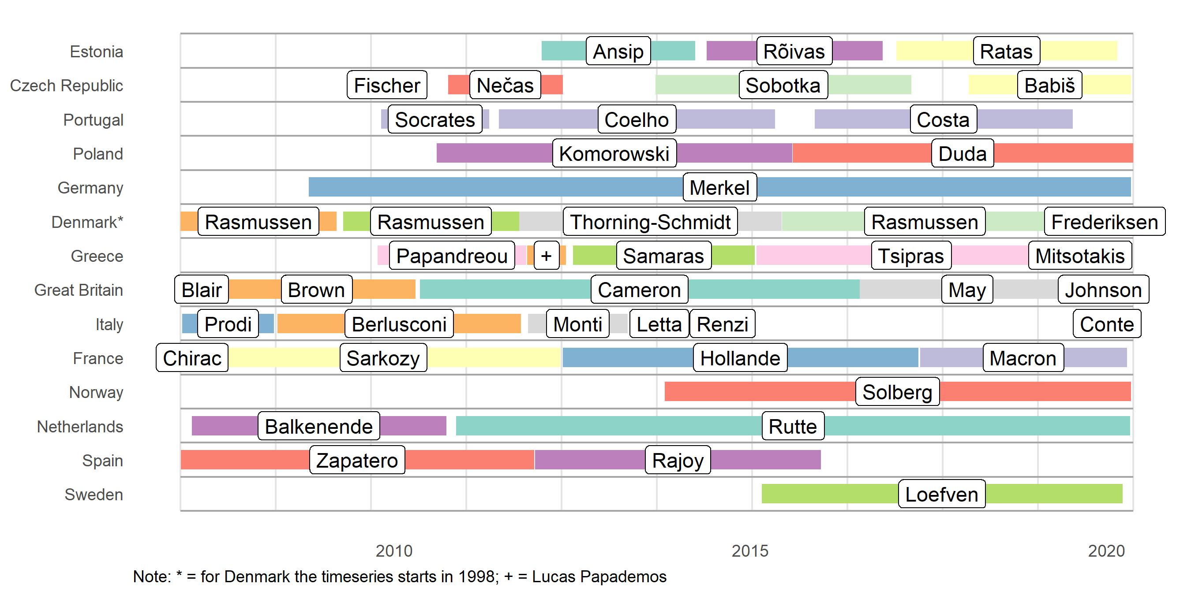
EUSpeech (version 2)

Slide 13
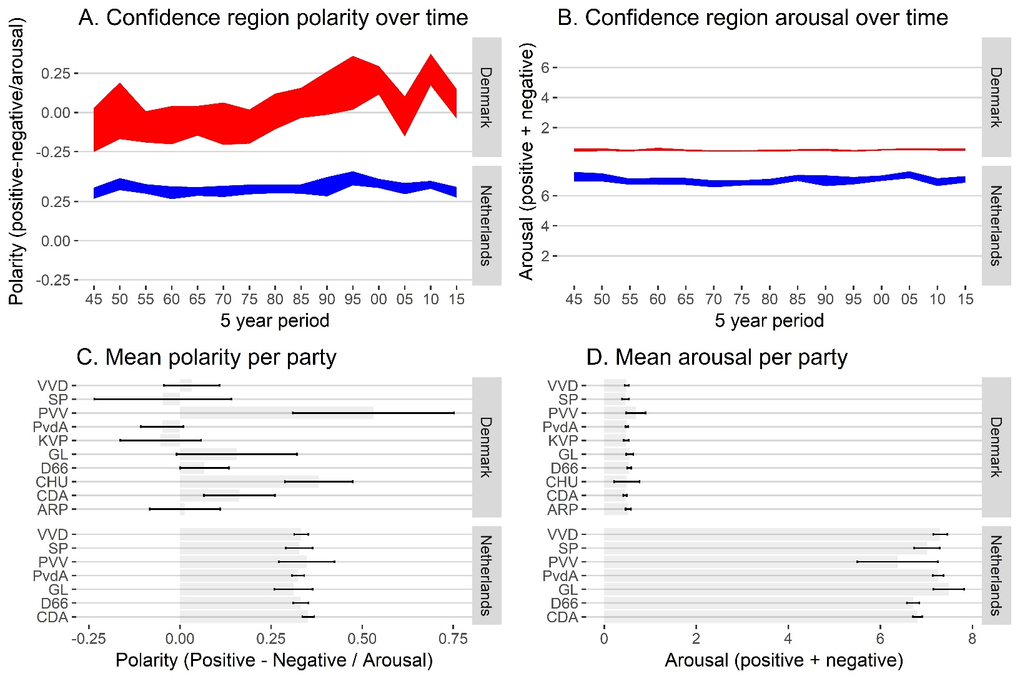
Party congress speeches
Note: Schumacher, Gijs, Daniel Hansen, Mariken A.C.G. van der Velden, and Sander Kunst. 2019. “A New Dataset of Dutch and Danish Party Congress Speeches.” Research & Politics 6 (2): 205316801983835. https://doi.org/10.1177/2053168019838352.
Notes:
But what to do with these methods and with this data?

Slide 14
Can we compare words?
Bag-of-words and by-catch (see Schoonvelde et al. 2019 JSPP)
Mistakes -> translation (de Vries et al. 2018, PA)
From general dictionary to topic-specific dictionaries (Pipal et al 2024 PsyArviv, Pipal 2024b. Sentitopics [R-Package])
Back to simple coding, but now by Chat GPT (see Gilardi et al. 2023 arXiv)

Slide 15
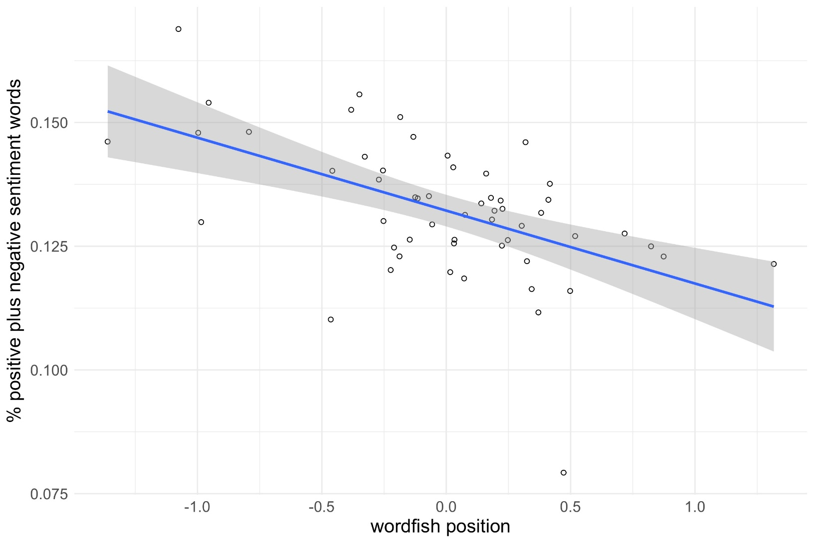
Catching both position and emotion
Note: Schoonvelde, Martijn, Gijs Schumacher, and Bert N. Bakker. 2019. “Friends with Text as Data Benefits: Assessing and Extending the Use of Automated Text Analysis in Political Science and Political Psychology.” Journal of Social and Political Psychology 7 (1): 124–43. https://doi.org/10.5964/jspp.v7i1.964.

Slide 16
Can we compare words?
Bag-of-words and By-catch (see Schoonvelde et al. 2019 JSPP)
Mistakes -> translation (de Vries et al. 2018, PA)
From general dictionary to topic-specific dictionaries (Pipal et al 2024 PsyArviv)
Back to simple coding, but now by Chat GPT (see Gilardi et al. 2023 arXiv)
Notes:
- Gaelic example

Slide 17
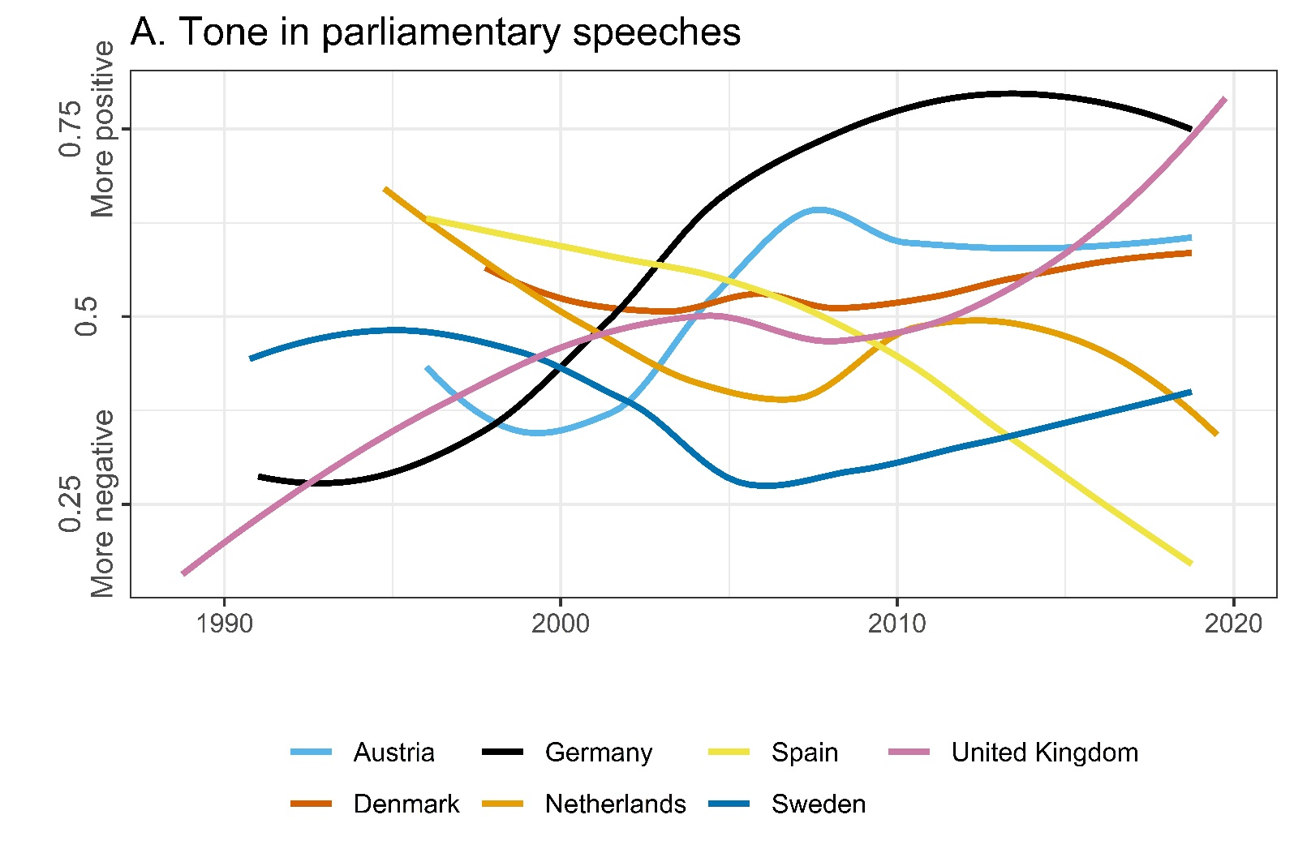
Politics is neither more emotional nor more negative
Note: The development of tone in parliamentary speeches in 7 different European countries. Specifically, the lines are LOESS regression lines based on quarterly averages of tone per country. Tone is calculated based on a sentiment analysis that takes into account the topic of the speech. Pipal, C., Bakker, B. N., Schumacher, G., & van der Velden, M. A. C. G. (2024). Tone in politics is not systematically related to macro trends, ideology, or experience. Scientific Reports, 14 (1), 3241. https://doi.org/10.1038/s41598-023-49618-9

Slide 18
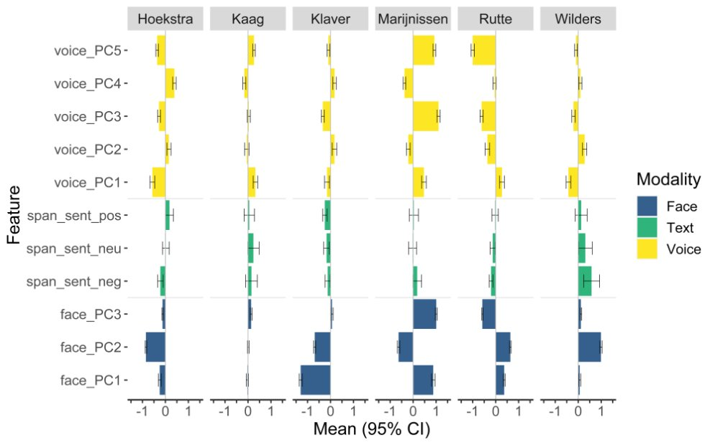
Going beyond text: MEXCA
Notes:
Make point about predicting labels

Slide 19
Predicting emotion labels
Predicting the emotion (a nominal variable) people experienced based on 18 appraisal dimensions (answers to likert items)
How to weigh the appraisal dimension to get the best prediction?
Used a genetic algorithm called Differential Evolution (Israel and Schonbrodt 2019), searches for optimal solution.
Note: Rebasso, Isabella. 2023. Feeling Within Reason: How Appraisals Shape Emotional Responses to Politics. Dissertation University of Amsterdam.

Slide 20
Predicting emotion labels
Note: Rebasso, Isabella. 2023. Feeling Within Reason: How Appraisals Shape Emotional Responses to Politics. Dissertation University of Amsterdam.

Slide 21
2. Methods to improve classification and prediction
Massive development but
Mostly descriptive
Did it explain more?
Confused prediction
Better alignment of these different goals
Notes:
- massive investment in fancier methods, but does it matter

Slide 22
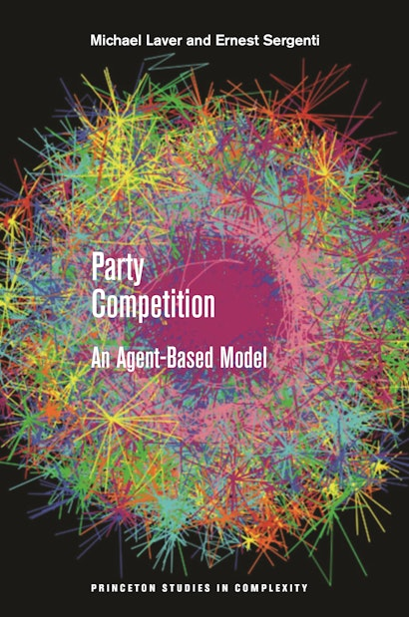
3. Building a Model
How do parties (decision-making rules) compete, and what is best for representation?
Aggregator rule outperforms other rules.

Slide 23
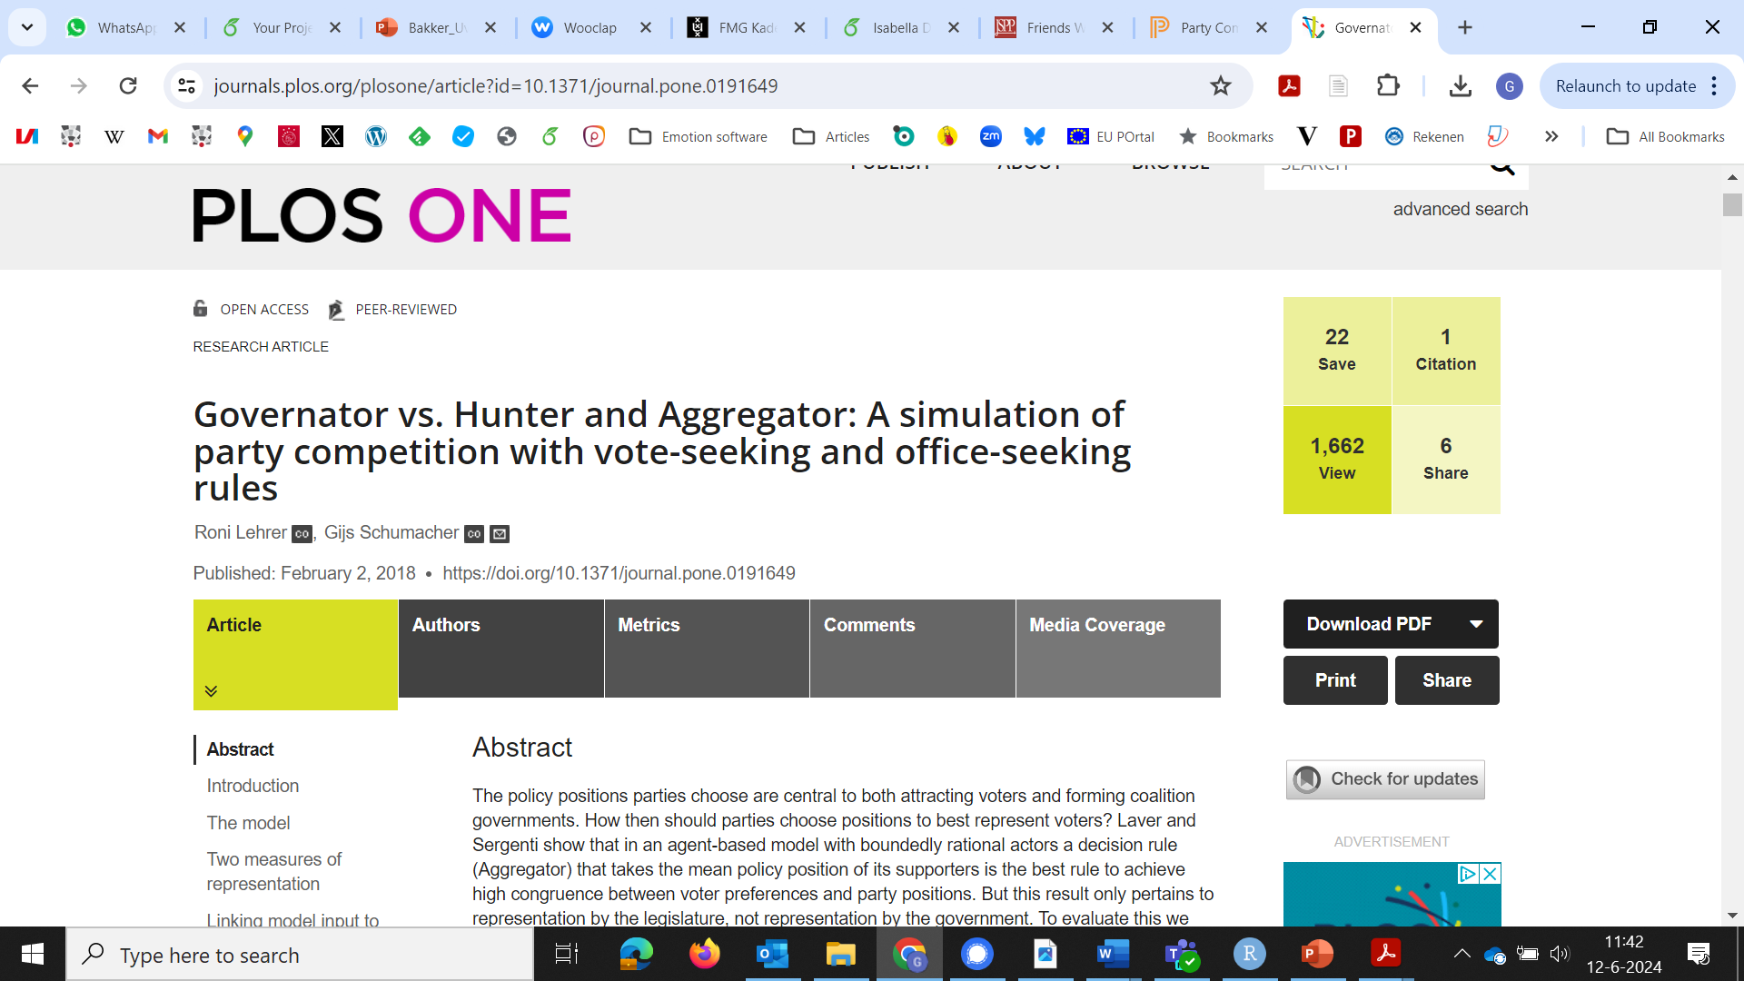

Slide 24
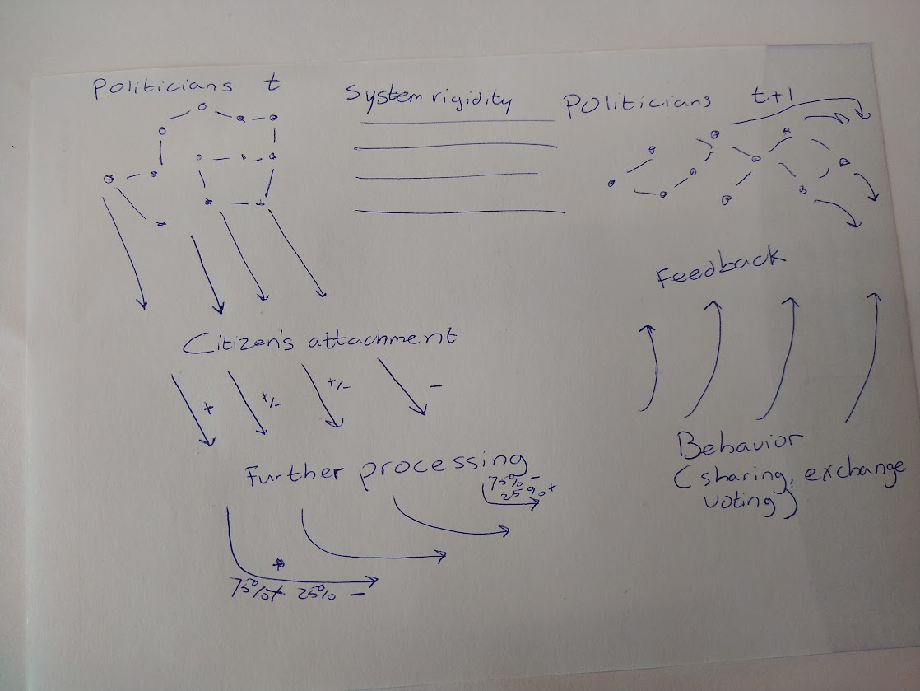
A Model of Affective Representation

Slide 25
A Model of Affective Representation
Aggregator; Hunter?
But how fixed are preferences?
Thermostatic model
Rational anticipation, Win-Stay-Lose-Shift

Slide 26
3. Building a model
Modeling dynamic relations between several elements vs a static understanding relations between two elements
Modeling elements that we cannot measure …
Building contrasting models
Notes:
Turchin anecdote ---

Slide 27
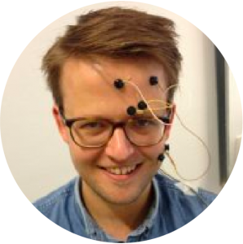







Follow us at hotpolitics.eu / #Hotpolitics(lab)
Bert Bakker
@bnbakker
Matthijs Rooduijn
@mrooduijn
Gijs Schumacher
@GijsSchumacher
Mariken van der
Velden
Isabella Rebasso
Maaike Homan
@maaikehoman
Christian Pipal
@christianpipal
Diamantis Petropoulos
Petalas

Slide 28
Appendix

Slide 29
Project conclusions
Politics is neither more emotional nor more negative
Citizens want more positive emotions
Emotion is deeply involved in political decision-making
Emotions about politics have a complex structure
Some people are more emotional about politics than others

Slide 30
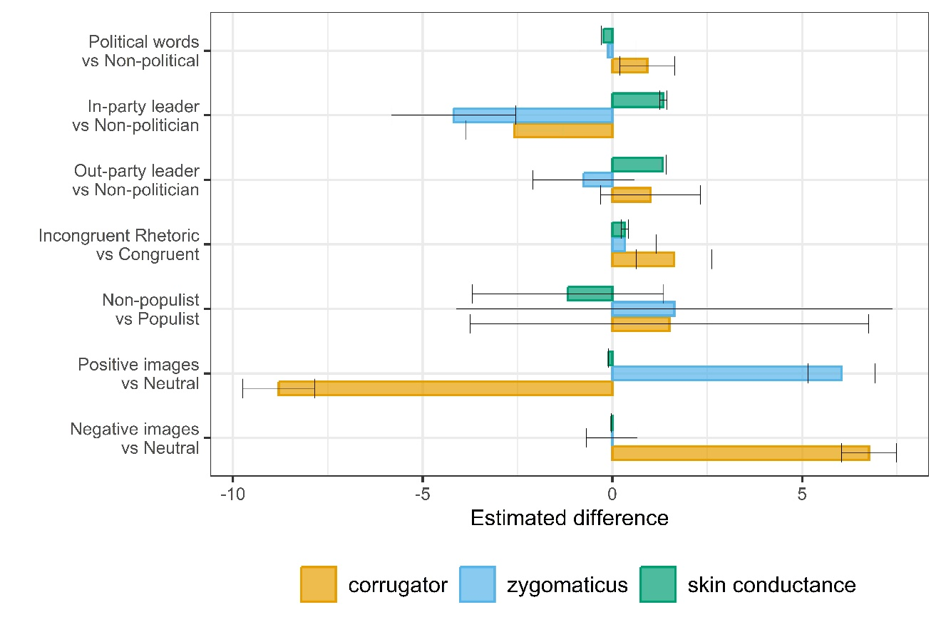
3. Emotion is deeply involved in political decision-making
Note: Figure is a collection of data from various studies. It shows again corrugator and zygomaticus activity as well as skin conductance. The results here are analyzed following the same specification. In these models the physiological activity is the dependent variable and the experimental condition specified on the y-axis the independent variable, see Bakker et al 2020a, Bakker et al 2020b, Bakker et al. 2021, Homan et al 2023, Schumacher et al 2022, Schumacher et al 2024, Arceneaux et al (in-press).

Slide 31
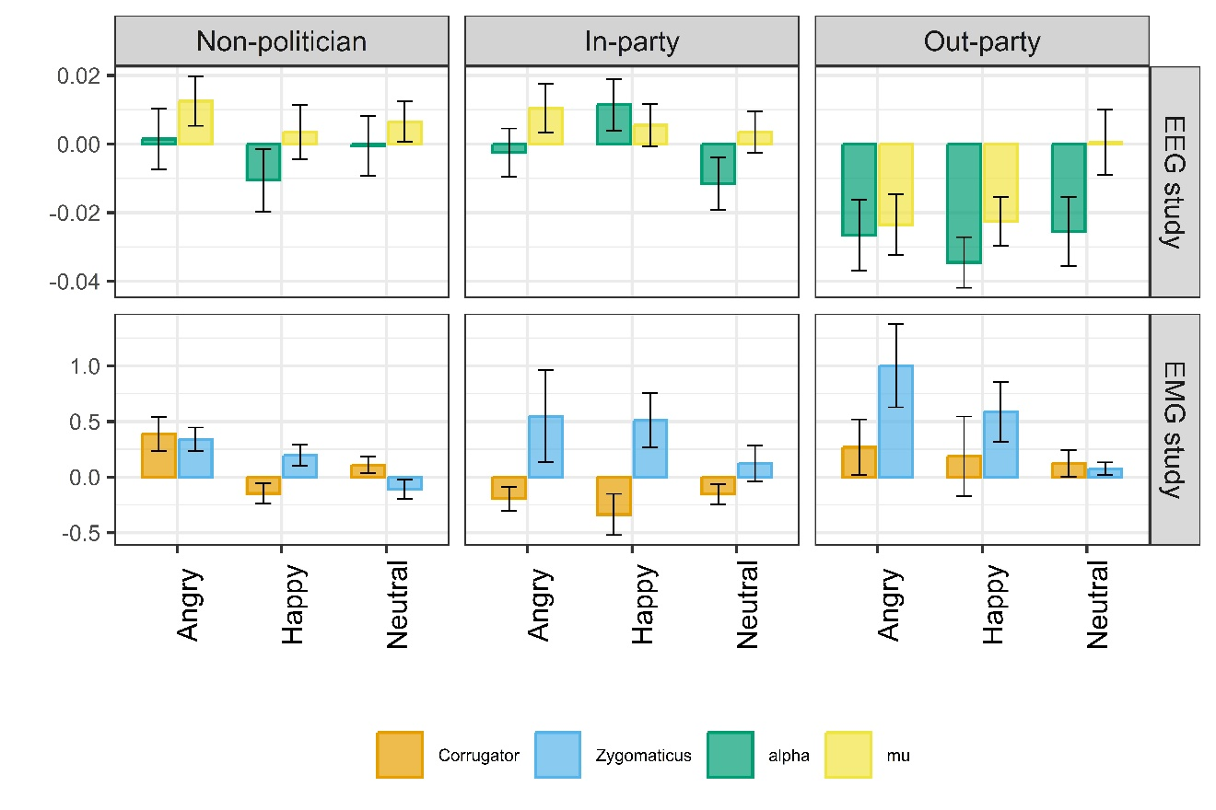
3. Emotion is deeply involved in political decision-making
Note: Figure shows data from two different lab studies with a similar design. In both cases participants were shown the image of inparty leaders, outparty leaders and unknown people. These faces were manipulated to show neutral, happy or angry expressions. During this the EMG study measured activity of the corrugator muscle and (associated with negative affect), zygomaticus muscle in the face (associated with positive affect), and skin conductance (associated with arousal). The EEG study measured mu rhythm (associated with perspective-taking) and alpha rhythm (associated with attention). See Homan et al. 2023, Homan et al. 2024.

Slide 32
4. Emotions about politics have a complex structure
More difficult to predict emotion labels from appraisals about politics than about everyday life (see Rebasso 2023).
There is a disconnect between self-reports and physiological activity (Bakker et al. 2020, Arceneaux et al. in-press).
There is a performative element in emotions about politics (see Pipal 2024).

Slide 33
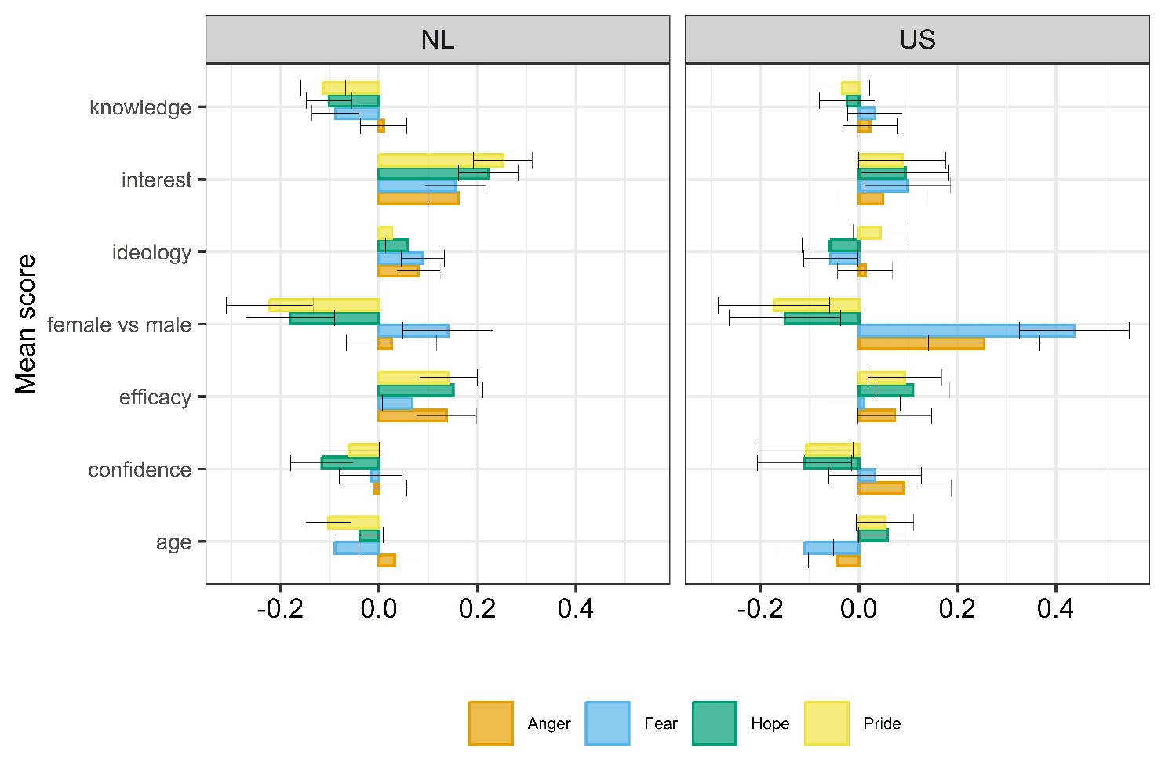
5. Some people are more emotional about politics than others
Note: Figure uses unique data from an American and Dutch survey in which people were asked to report how much anger, fear, hope and pride they felt about politics. In addition the survey asked participants about their gender, age, political interest, knowledge, perceived knowledge and efficacy. Using a linear regression model we set the emotion as dependent variable and the aforementioned variables as independent variables. The plot shows the regression coefficients and 95% confidence intervals. See Rebasso 2023.

Slide 34
Next steps
More fine-grained multimodal mapping of emotions in the domain of politics
Emotions are dynamic, recursivity; elite or network cues.
Emotions as a problem or opportunity of representation

Slide 35
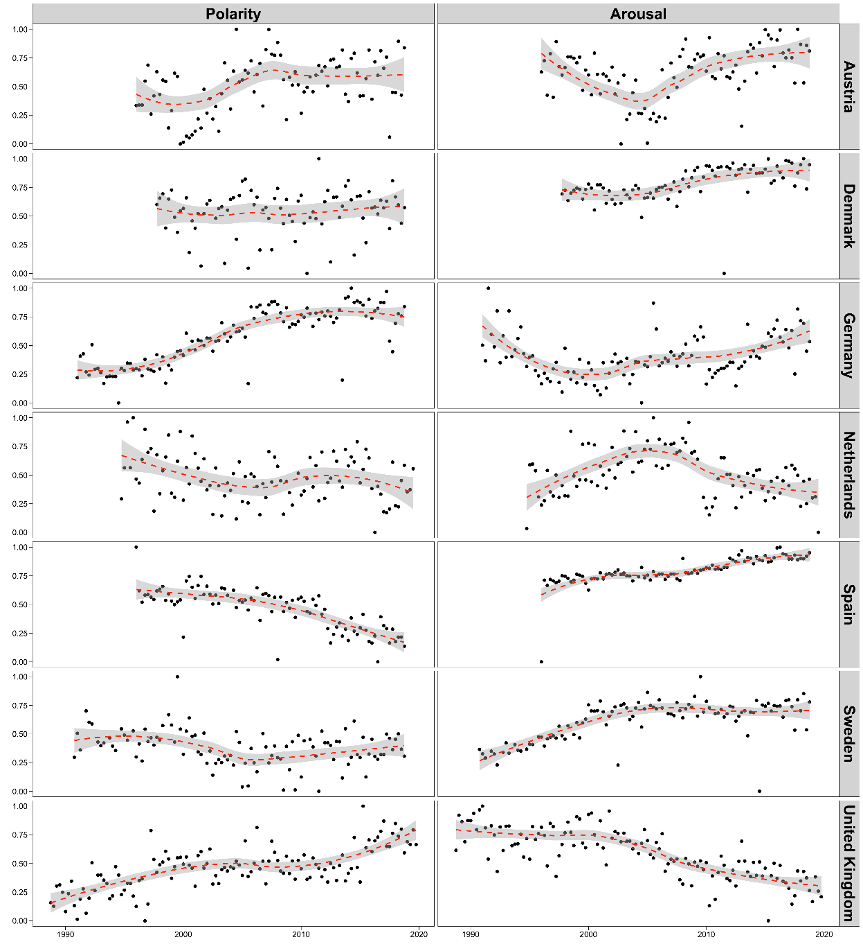
No time trend in tone
Explanation: using parliamentary speeches from 7 countries over a period of 30 years, we estimate emotional tone (arousal and polarity). We use a joint sentiment topic model for this, that takes into account the arousal and polarity of words, as well as the topic in which these words are clustered. Each dot in the figure is the mean arousal/polarity per quarter.
Pipal, Bakker, Schumacher & van der Velden. Tone in Politics Is Not Systematically Related to Macro Trends, Ideology, or Experience. Under review. https://osf.io/dw6b9/

Slide 36
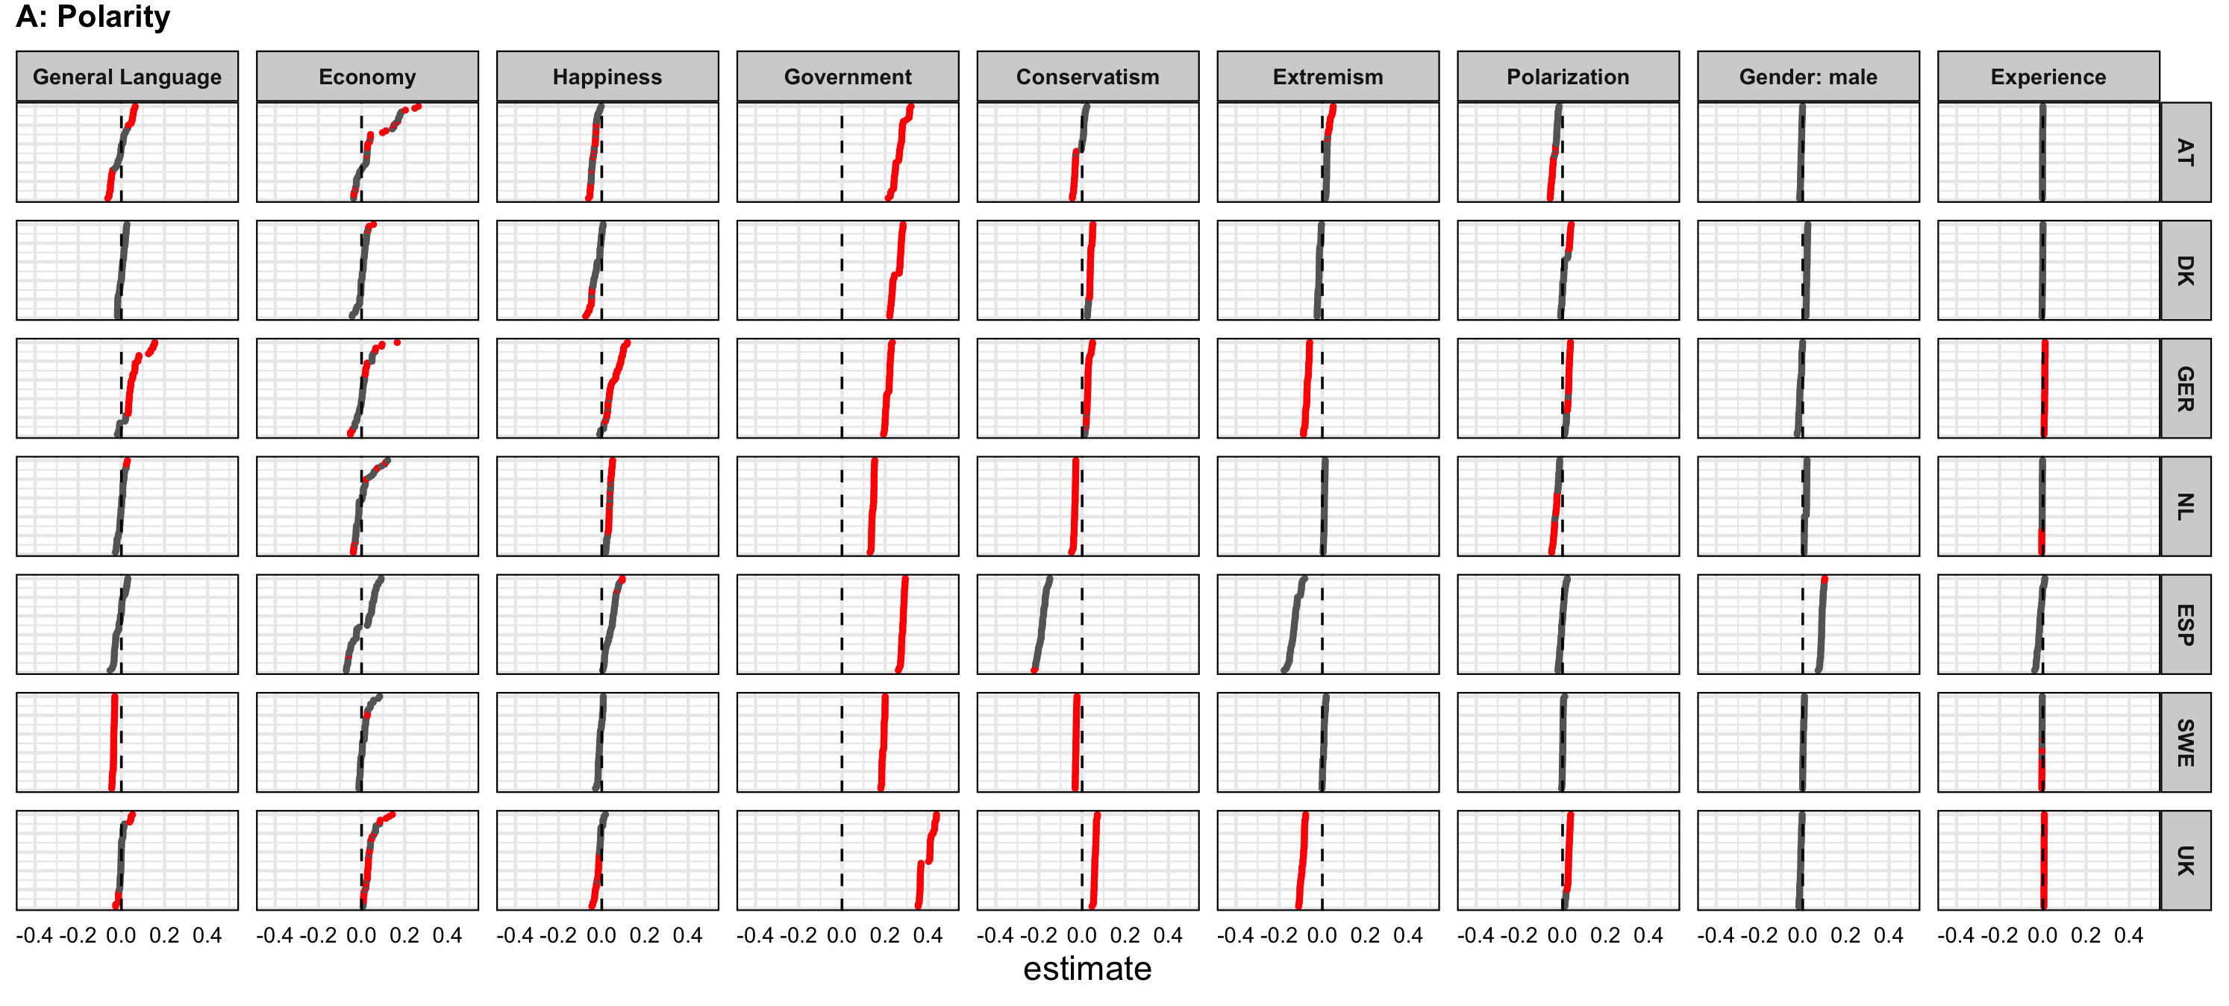
No single explanation for variation in tone, except for ….
Explanation: each dot presents the effect of an indendepent variable (see columns) on polarity (negative-positive tone) in parliamentary speech. There are multiple dots because we ran multiple models (multiverse approach). Each row represents analysis from a single country. Data comes from parliamentary speeches over a ~30 year period. Red dots are significant, black dots insignificant.

Slide 38
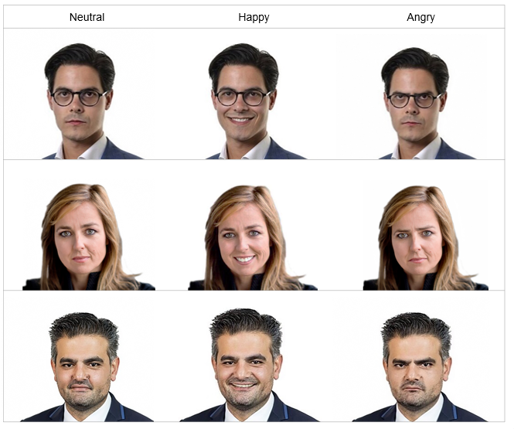
The effect of facial displays

Slide 39
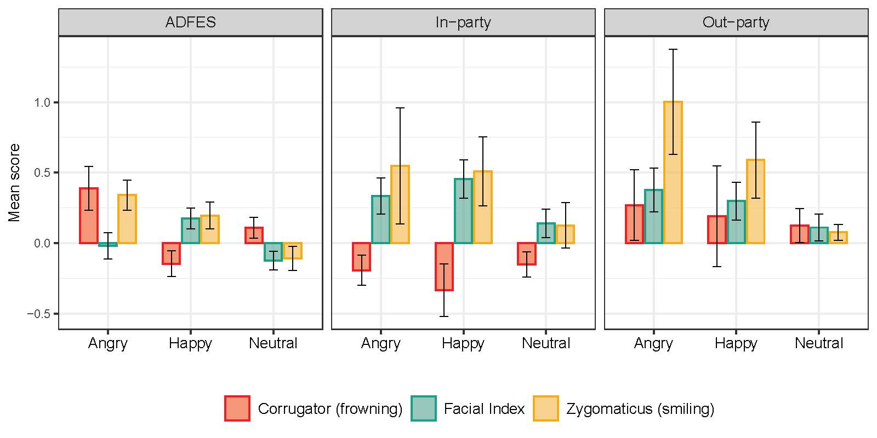
Outparty politicians generate strong physiological responses
Reference: Homan, Schumacher and Bakker (2022) Facing Emotional Politicians: Do Emotional Displays of Politicians Evoke Mimicry and Emotional Contagion? Emotion. https://psyarxiv.com/7edzh
Notes:
How “affective” is affective polarization?
Is saying you dislike outgroup members just some signalling behaviour? Or is there some deeper affective process?
fEMG responses
Different categories: normal people vs politicians
Difference inresponses between ADFES and politicians ---- ‘politicians’ has particular affective qualities
We do not find evidence for some standard theories in psy
Difference between in-party and out-party: angry condition. Angry outparty politician: people laugh at this person
In addition to affective polarization, i think we can bring another concept from polisci to psy

Slide 40
Outparty politicians generate strong neural responses
Explanation: Log power mu rhythm and alpha signal) for the different conditions. Black dots represents the mean estimate per group, the black whiskers the 95% CIs, and the clouds the sample distributions.
Reference: Homan, Hamdan, Hendriks & Petropoulos Petalas. Neural Responses to Emotional Displays by Politicians: Differential Mu and Alpha Suppression Patterns in Response to In-Party and Out-Party Leaders

Slide 41
What is the effect of facial displays?

Slide 42
Smiling works
Explanation: each dot is the marginal mean of an experimental stimuli on vote choice. 0.5 means 50% chance of voting for a candidate with that feature. Bars are the 95% CIs.
Reference: Homan and Schumacher. Examining the Influence of Politicians’ Emotional
Appeals on Vote Choice using a Visualized Leader Choice Task. https://osf.io/vhdc3/

Slide 43
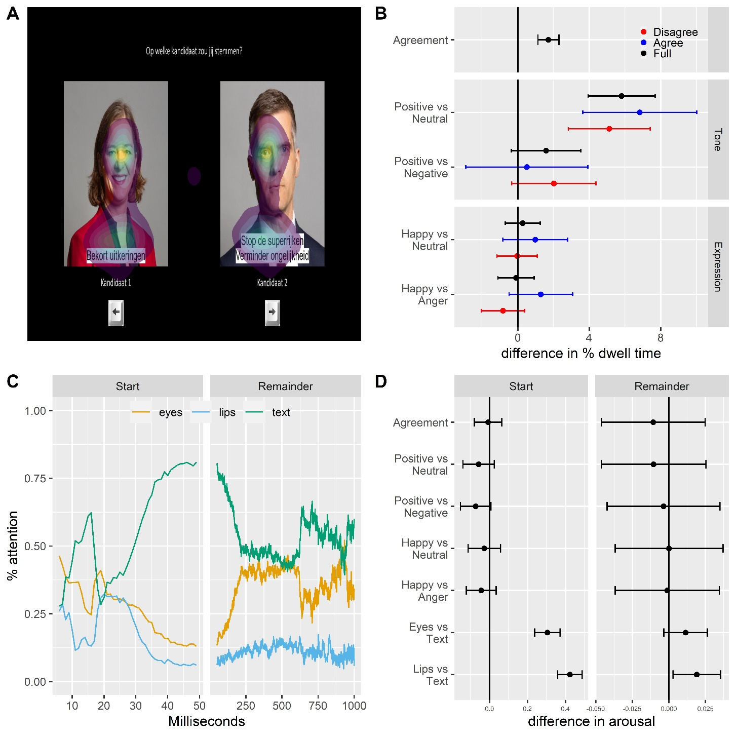
Processing the posters
Lab study with eyetracking, fEMG, skin conductance and thought listing tasks. Preliminary results: we look more to candidates we agree with, we also first attend to the expressions of those candidates.

Slide 44
The effect of language
Appraisals of certainty, control and responsiblity distinguish between anger and anxiety.

Slide 45
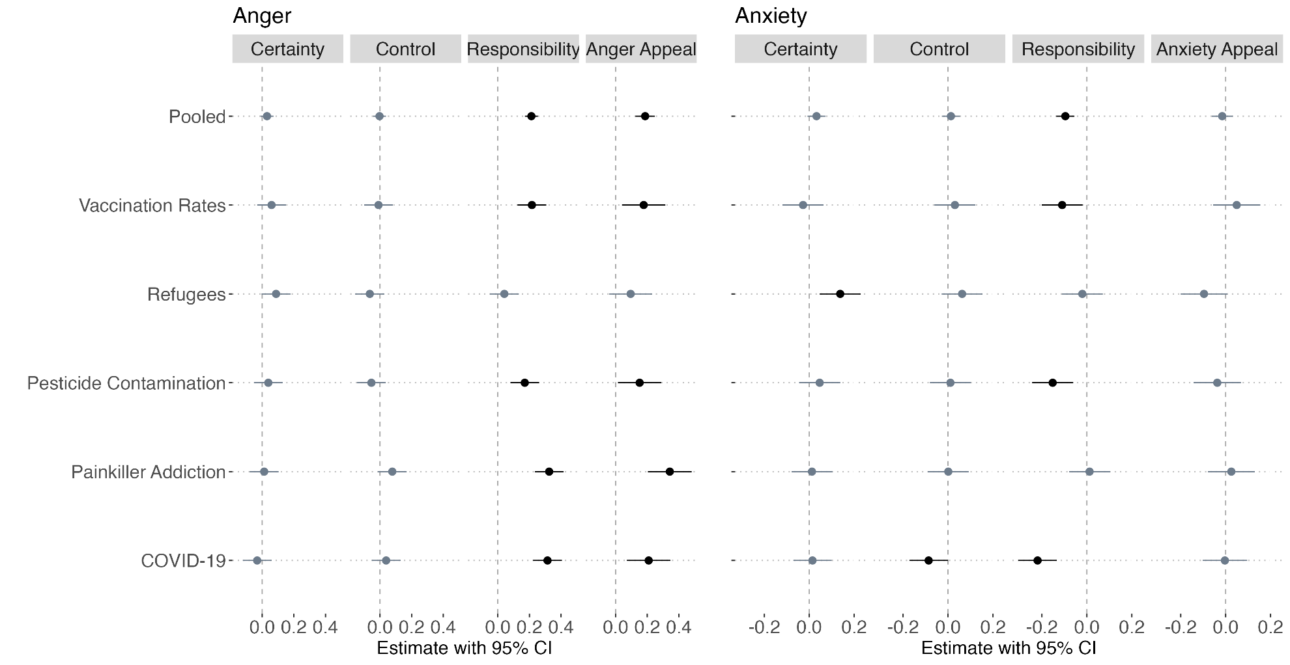
Appraisals elicit anger but not anxiety
Reference: Rebasso and Schumacher. Using message appraisals to elicit anger and anxiety
responses to political issues: Two preregistered experiments.

Slide 46
Do Appraisals match Emotions? (I)
Emotion appraisal Task
Describe and label an emotional event
Answer appraisal questions (e.g. certainty, control)
Match predicted emotion (based on appraisals) with labelled emotion.
Works well with emotional events in personal life, but falls apart when we ask for emotions about politics
Particularly, distinct negative emotions cannot be predicted from appraisals
References: Rebasso and Schumacher. Affective Modeling of Emotion Labels in Politics.

Slide 47
Do Appraisals match Emotions? (II)
What does this mean?
Unique theory of emotions in politics?
Engaged people even harder to predict: cueing?
Emotionally dysregulated in our political life?
Are the emotions justified?

Slide 48
Other project output
On methods
On affective representation
On ideological asymmetry
On decision-making

Slide 49
Project conclusion
Context
From the brain to the self-report, from citizens to elites.
Hierarchy and loyalty
(a few more months to go for more conclusions)

Slide 50
Season Finale or Series Finale?
Approach emotions multimodally
MEXCA
Alignment of emotions
Should affect and feelings be more connected in politics?
Politics as a cause of emotion.
Neural processing of emotional appeals

